Slide 1
Quality Assurance & Approvals
Tim Walker
Mario Club Supervisor
Notes:
· Man he's scary . . .
· Tell me you haven't wanted to do that (shoot one) to a QA guy at some point?
· It didn't seem right to shoot myself, so Dante has graciously acted as my alter-ego
· knock ou of stupor
· staged this stunt to make a point. That being, we know there is
typically a lot of apprehension, and even cynicism around QA and that
· fears out in the open - to put them to rest (pun intended) - before we talk about how NOA's QA process really works . . .
· next half hour - step through our QA process - alleviate apprehension
Though, it didn't really seem right to shoot myself ‑ or
does it? You'll have to be the judge of that.
Did we at least knock any of you out of your mid‑day stupor? (Expect
silence ‑
The thought of it seems about like as much fun as visit to the proctologist.
We promise theirs lollipop in it for you at the end.
(Yes)While we are committed to quality gaming, (but) I think you'll find us
rather reasonable to work with, and that their are actually a good number of
advantages to you as a result of our QA process.

Slide 2
Why Quality Assurance?
Consumer expectations are high
Every game is a Nintendo game
When you look good, we look good
Higher level of game quality
Notes:
· The consumer is going to expect significant improvement in game quality to justify purchase of new hardware
· Every game is a Nintendo game - in consumers' eyes - every
· When you look good, we look good - cheesy, but true
· in end we want the highest quality games for our systems - is that so wrong?

Slide 3
How?
Give top developers information early
Ongoing technical support
NOA QA process (a cooperative effort)
Notes:
· what can we do to help this happen?
· first thing - "hand pick" the top CGB developers & publishers - give tools and info early on - like today's conference.
· yes you are special
· you have time and info you need to make a great game
· ongoing technical support -familiar avenues (web sites, software engineering support group)
· Lastly - work together throughout development of each game - starting with concept up through MC and LC approval

Slide 4
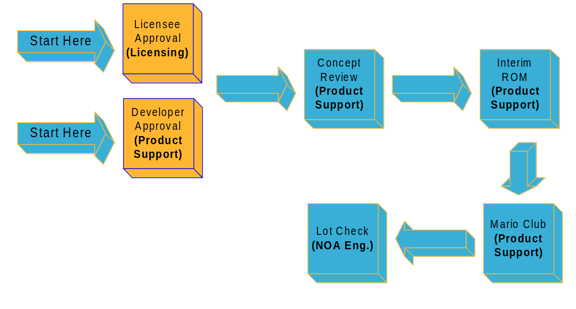

The Pipeline
Notes:
· So let's dive right in
· Here's what the process looks like
· looks familiar eh?
· on surface the same format as CGB and N64
· single biggest difference is full MC eval - unlike CGB which is color only
· important to mention MC now - concept and irom review centered around it
· wont talk about LC, still working out details
So this is the goal, to pass Mario Club. Now I'm going to take you through process we've put in place to help you get there.

Slide 5
Developer Authorization
Why?
  We need qualified and capable developers
How?
  Evaluated by software engineers
What?
  Prior works and references
  Human resources (technical, creative, managerial)
  Business organization
Notes:
· be brief - this doesn't apply to you
· you were selected to attend wouldn't be here if we weren't confident you are capable
· want developers with proven track record
· for Licensees - contact Melody - if other devs

Slide 6
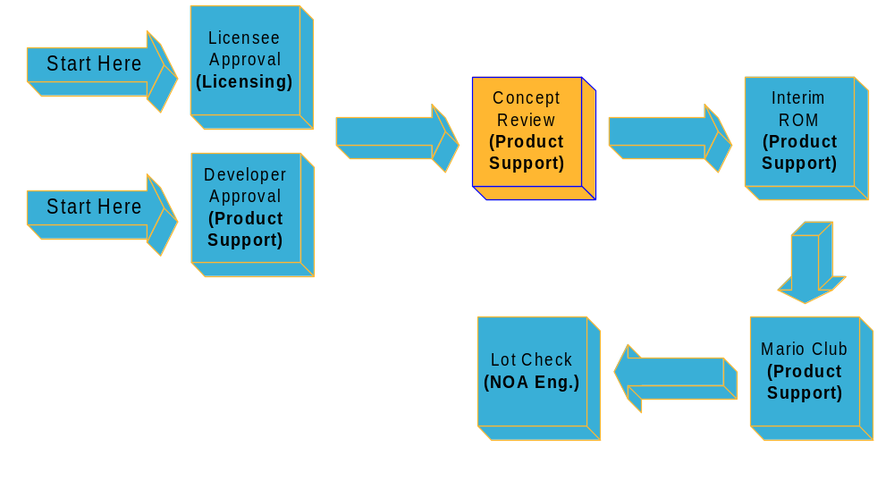
The Pipeline

Slide 7
Concept Submission
Concept submission is required
Essential to tracking development
Reviewed by Mario Club and software engineers
Get feedback on your design
Great preparation for Mario Club approval
Notes:
· Yes, it is required - not approval - consultative or advisory stage
· submitted for review at start of development
· gather the info we need to track titles in dev
· make projections based on your sched
· give feedback on design - tech & creative
· prepare for MC - good game starts with well thought out plan

Slide 8
Concept Review
"Advanced" features
Game design
Schedule
Developer
Notes:
· more than a slight hardware upgrade
· not a 2 Mhz Z80
· we're talkin' 128 obj single line - scale, rotate, transparency - very cool
· PCM sound
· New levels of control - 2 new buttons
· lets show the player what this thing can do
Game Design
· Tell us about your game.
· look and sound like?
· main objective, story-line, secondary objectives?
· help us visualize the experience
· design doc is easiest
· any feedback is usually high level
· things like Game progression, motivation
· Accomplishment & reward
· Mario 64 design example
Sched
completion and release
o milestones
o helps us know if game is available for trade shows and the like
o Realistic & achievable
Dev & Pub
- Authorized?
- Name and contact
THIS AND ALL INFO IS STRICTLY CONFIDENTIAL

Slide 9
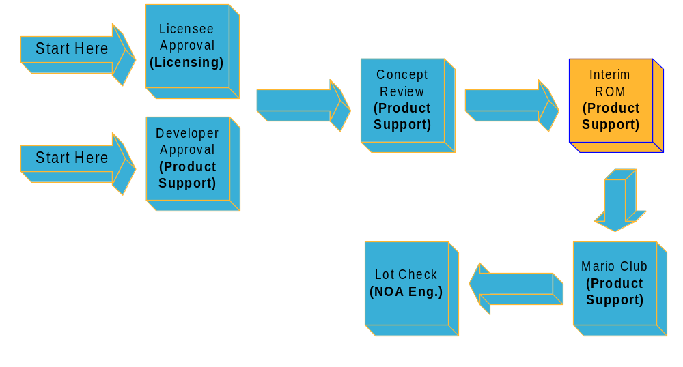
The Pipeline

Slide 10
Interim ROM Review
Works in progress
It's all in the execution...!
Notes:
o established the game looks good on paper
o moves us into next phase - irom

Slide 11
Interim ROM Review
Two required (50% and 75% recommended)
Feedback when you can use it
Game play evaluated by Mario Club
Technical review
Facilitates tracking game progress
Notes:
Based milestone schedule completion date
o The general guideline is 50 & 75% - depending on approach to dev - could be slighter different. well work it out
o single most important part of the process easing the path to final MC approval
o First time seen by MC - eval based on same categories as final
o feedback when you can use it - rarely a validity issue with feedback - time
o what you do with it is up to you
o . Depending game state - can focus on specific aspects of the game.
o Tech review - use gamma correction example -
o touch bases on sched - still on target?

Slide 12
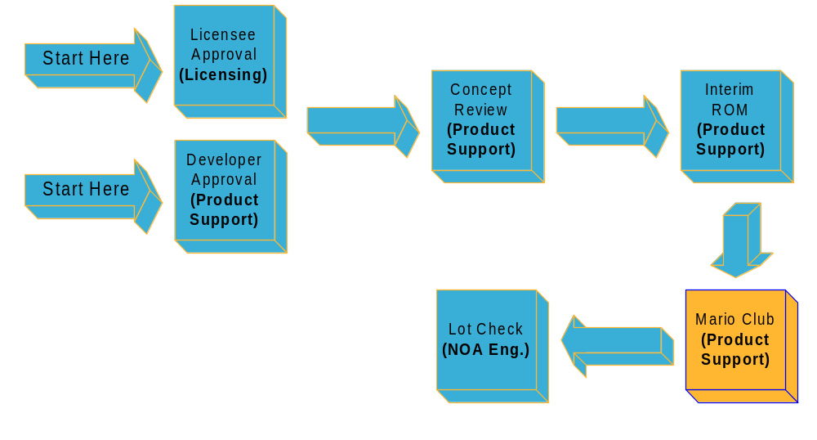
The Pipeline

Slide 13
Final Mario Club Submission
Complete game evaluation
  Not just use of color
When the game is 90% complete
  Playable
  Bug tested (minor bugs OK)
  Feature complete: all levels, stages, characters, etc.
4 weeks (min.) Prior to Lot Check
Notes:
o AGB games will undergo a complete evaluation for approval consideration, not just use of color as we do with CGB.
o conservatively estimate 4 week so you have time for refinement (if needed) based on MC feedback.
o closer we work during the development of the game, the less of a concern final MC approval becomes.

Slide 14
Mario Club
“A game evaluation system that provides comprehensive, qualitative feedback to licensees & developers from experienced, knowledgeable evaluators”
Notes:
o So what is Mario Club?
Johnny - tell them what they've won - read above

Slide 15
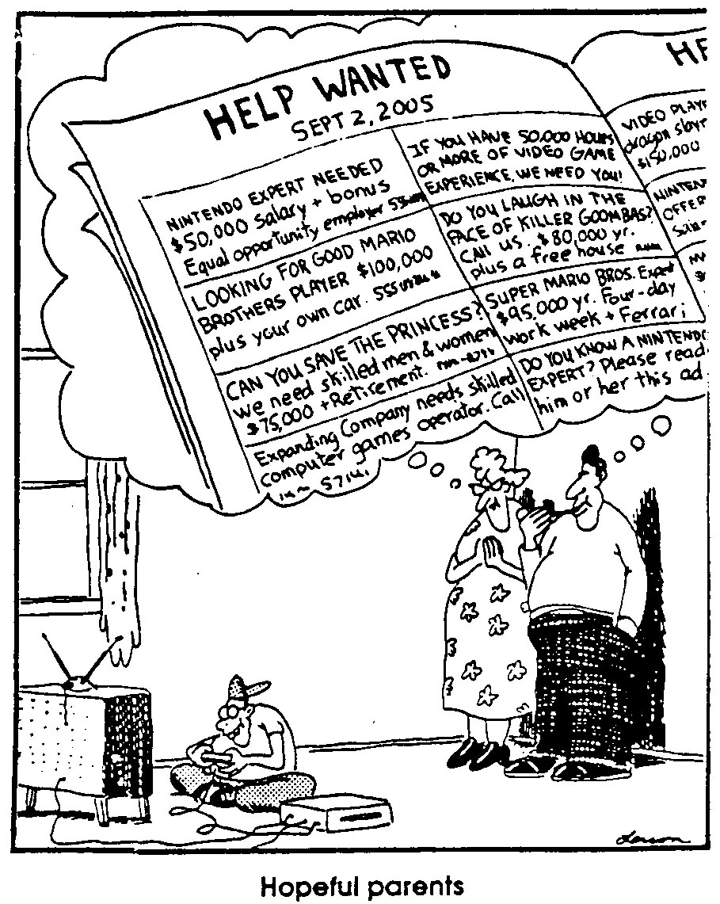
Who is Mario Club?
Experienced, full-time evaluators
Wide range of experience and tastes
Effective communicators
Notes:
o So what is Mario Club?
o Read corp line
o In a nutshell . . . group of 10 experienced game players - hired to act as the eyes, ears, and fingers of your consumer
o Probably started out something like this guy (refer to cartoon)
o envy of every kid in America
o similar to focus or play test group - except . . .
o Played every N64 and CGB since release
o each selected for their ability to articulate their likes and dislikes of any game from the viewpoint of the target user.
o wide range skill, experience, interests.
o Some like sport games, action, arcade style, sims. Just like your consumer.
o impartial play test group - motivation to make good games great and bad games better.
o "they take fun seriously" - cheesy but true

Slide 16
Mario Club
Approval required before game can be submitted to Lot Check
Valuable resource for improving game quality
A "fresh set of eyes" never hurts
Used for Nintendo titles too
Notes:
o impartial play test group - motivation to make good games great and bad games better.
History of game eval programs - not cooked over night - this is latest refinement
o At least, the MC eval will give you a fresh perspective
o comfort to know that MC evals Nintendo titles as well - often several times until complete and polished.

Slide 17
Methodology
10 full-time game evaluators
Minimum of 4 hours game play
  Depends on game depth
Individual written evaluations
Moderated round table discussion
Summarized reports provided to Licensee

Slide 18
Criteria
Games scored in 5 weighted categories, total score ranges 0-100
Visual - 10%
Audio - 10%
Ease of play - 20%
Game consistency - 20%
Satisfaction - 40%
Notes:
o evals based on 5 major categories - broken down into specific criteria.
o examples below
o EOP - Play control, play response, game tempo, intuitiveness
o Consis - Balance of difficulty, theme consistency, rules consistency,
o Satisfaction - sense of accomplishment, depth, originality
o Each category has been assigned a weight that reflects the relative importance of each.
o each evaluators rate each category on a 1-5 scale in .5 increments
o multiplied by a predetermined factor (such as 2 for visual and audio and 8 for satisfaction) so that we end up with the 0-100 range.

Slide 19
Mario Club approval
Average final game score ~69.5 (N64)
Majority vote
Not determined by score alone
Notes:
o what score is needed?
o several reasons not score alone.
o potential for the score to be manipulated to fit the need is too great.
o score no longer effective measure of the game's quality.
o It also allows for important issues to go ignored. For instance a soccer game may score a 70, even though the all-important passing play- mechanic is difficult to use. It's like a Porsche with square steering wheel. Sure it's a nice piece of work - hand built, 300+ hp, leather seats, killer sound system . . . but what fun is it to drive with that square wheel
o Great movie with a bad ending.
o majority vote is used for pass/fail
o So what's a good score? 80+

Slide 20
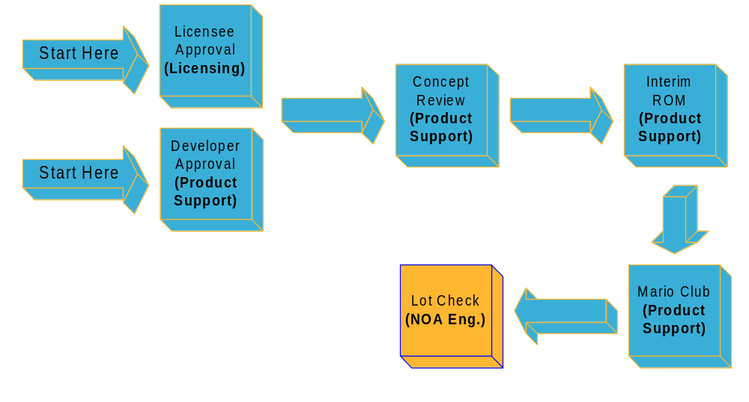
The Pipeline
Notes:
Ok - when its all said & done heres what it looks like you send us a concept, we give you a little feedback, you send us a irom, we give you a little feedback, you let us know what you think (about our feedback), we talk about it, we look at the game again, give you a little feedback, you tell us what you think, we work it out, the game goes in for final, we're good.
The key to success is to keep us in the loop
We want you to be successful and I think you’ll find us to be very reasonable to work with.
It is only when the line of communication breaks down that problems and headaches arise when it is time for making the grade with MC.
We want the same things: quality games and wild success at retail.

Slide 21
Lot Check
Required before manufacturing
Hardware compatibility testing
Conformance to programing cautions and guidelines
NOA and NCL testing

Slide 22
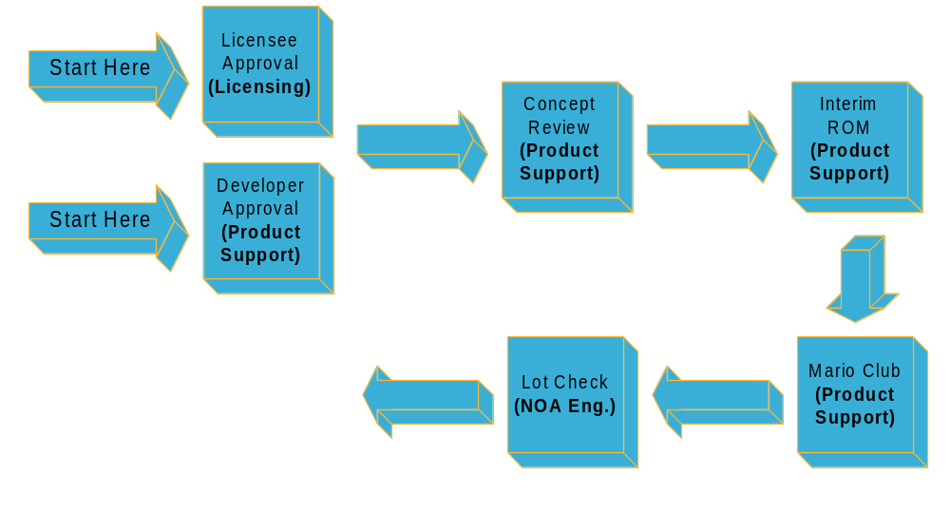

Ship It!

Slide 23
The Gain
Hardware potential is realized
A satisfied, happy player
Higher level of game quality
Longevity of AGB system sales
Notes:
In addition to the above gains (read them)
you also increase your chances of (next slide)

Slide 24
What's in it for me?
Co-op Advertising Opportunities
Product Acquisition
Trade-show Presence
Notes:
all these things are based in part on MC eval and rating

Slide 25
FAQ's
What about acquired titles?
What if my dog ate my concept?
My game scored an 80 in MC. How many pieces should I order?
Notes:
(Mario club scores should not be used as sole the measure of potential sales. Other factors have stronger influence.)

Slide 26
Closing Wish
"If we've done our job, Mario Club approval becomes a formality and your greatest worry is keeping your product on the store shelves"

